Slide 1
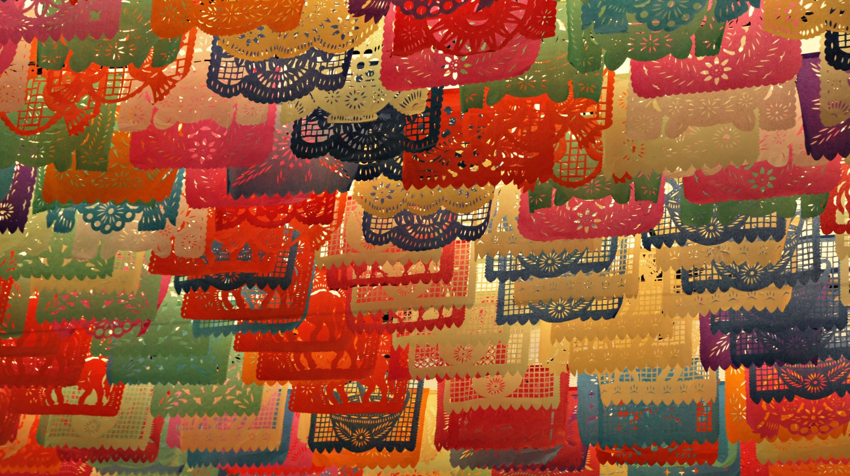
Sociology of Culture

Slide 2

CYCLES OF CULTURAL PRODUCTION AND CONSUMPTION

Slide 3


Slide 4
The Solitary Artist?

Slide 5
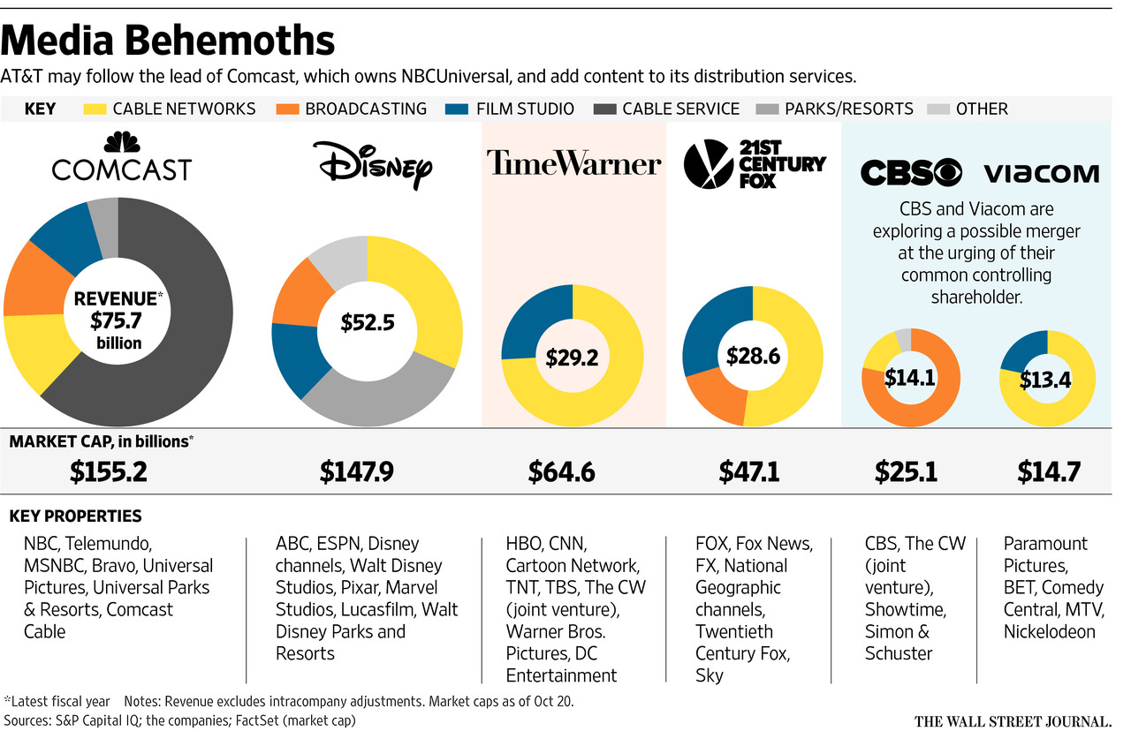
Who produces the culture we see?

Slide 6
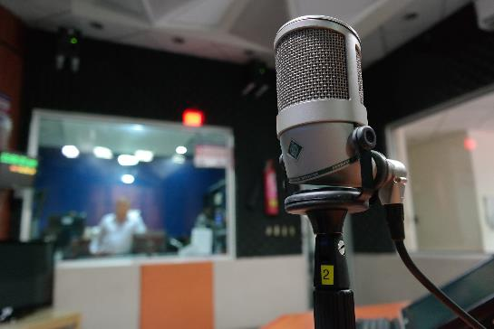
The Production of Culture
This perspective aims to examine how macro-level (large-scale) arrangements in the culture industries (e.g., laws, technology) shape innovations and standardize cultural production
Over time, changes in those macro-level forces are critical factors in making the culture we see and hear

Slide 7
Corporations and Culture
Corporate consolidation—the acquisition of smaller corporations by larger ones—has created a more homogenous symbolic and material cultural landscape
Do culture industries drive consumer tastes, or do consumer tastes drive cultural production? What are some examples?

Slide 8

Consuming Culture
When we buy, read, or watch culture, we actively interpret what we see and hear
We fold their meanings into our own understandings of the world

Slide 9

We are the ones who interpret culture, regardless of its original message
What is an example of how a cultural good was misinterpreted by a group or evolved away from the author’s original intent? What, do you think, led to the misreading?
Are there any songs that you liked until you realized that the song was about something you didn’t initially notice?

Slide 10

How Culture Works

Slide 11
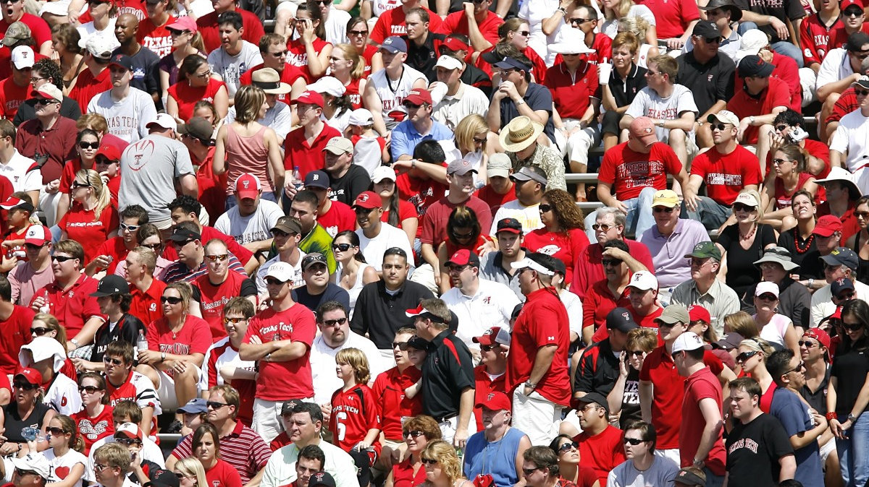
How Does Culture Make Groups?

Slide 12
Culture and Groups
Culture helps us generate and define “us” groups and “them” groups.
While there are social boundaries (i.e., inequalities in access to resources, like race, class, gender), there are also symbolic boundaries (i.e., the conceptual ways people separate each other into groups, like traditions, styles, tastes, classifications).
Bridges vs. Fences

Slide 13
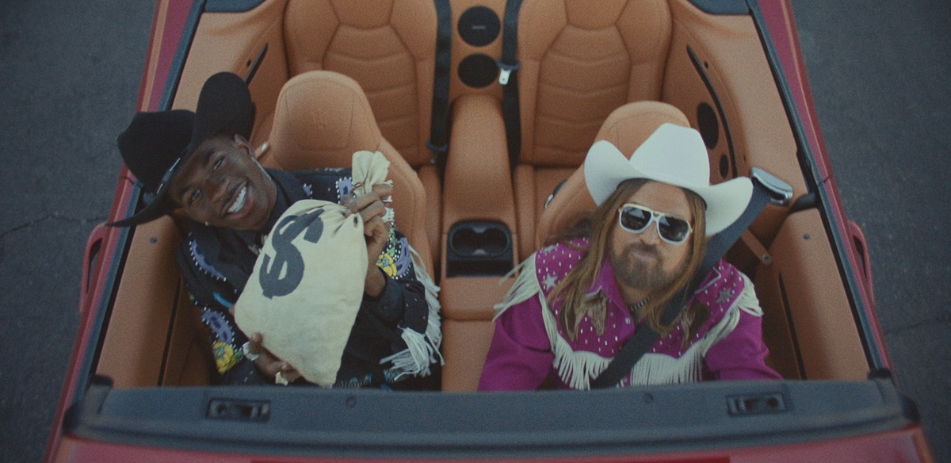
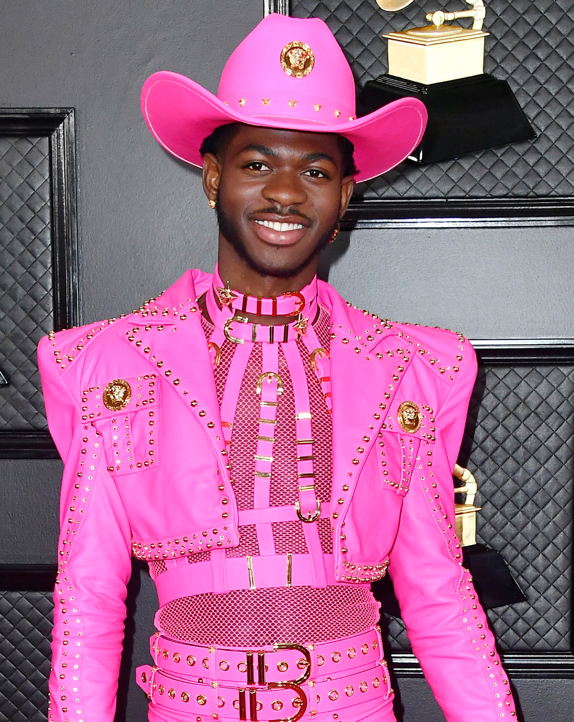
How Does Culture Make Groups?
Is “Old Town Road” a country song or a hip hop song? How do you know? Why is it important?

Slide 14

What about APT?
What genre is this and what does it matter?

Slide 15
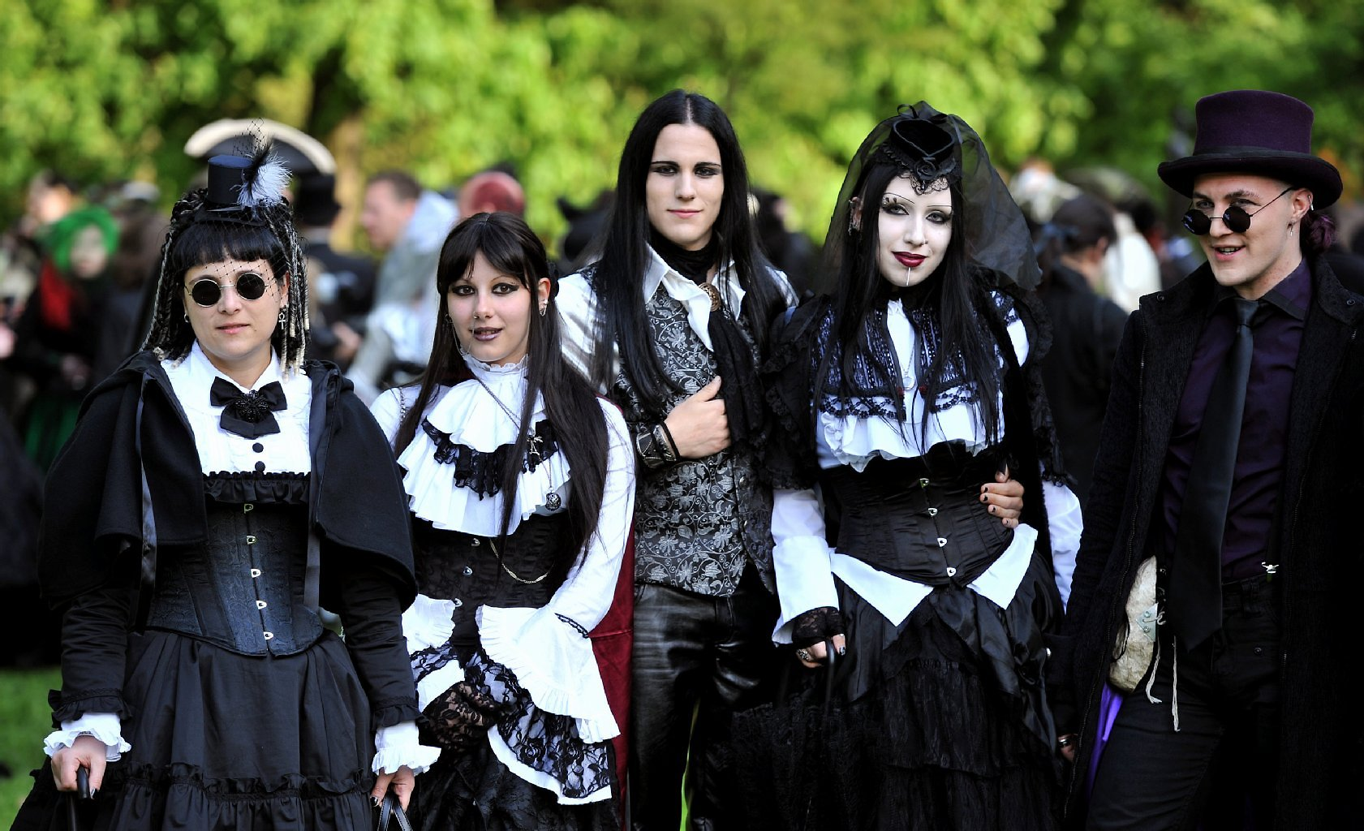

Subcultures
Subcultures differentiate themselves from the wider culture through symbolic and material means, often adapting and repurposing existing cultural goods for new purposes

Slide 16
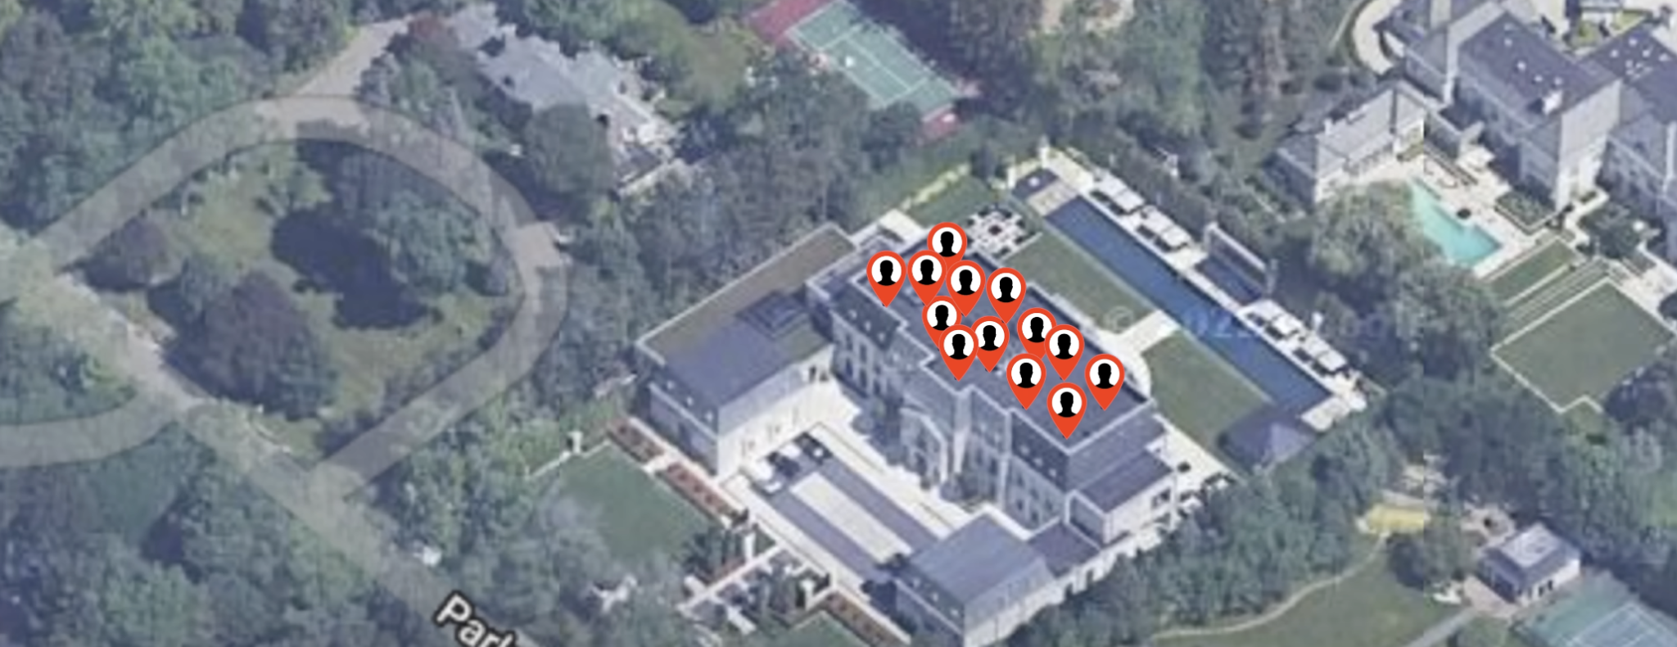
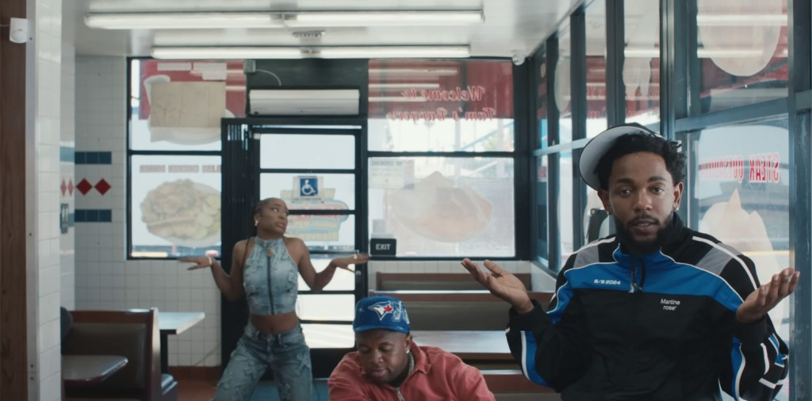
Subcultures can become mainstream
In some cases, they can become commercialized
The boundaries are fluid

Slide 17
In-Class Discussion Board
What is an example of a subculture that has been commodified? Conduct a brief online search in groups and describe (specifically what is being commodified) or screenshot an example of subculture commodification.
Ex: Hiphop, goth, etc.,

Slide 18

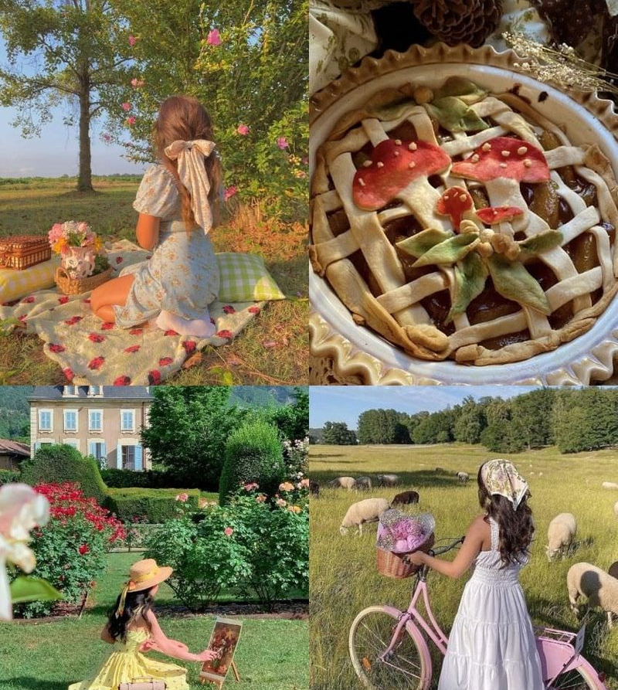

What about Aesthetics? Do these count as subcultures?
Dark Academia
Cottagecore
Old Money
What other aesthetics are there?
What cultural values or norms do they emphasize or subvert?

Slide 19
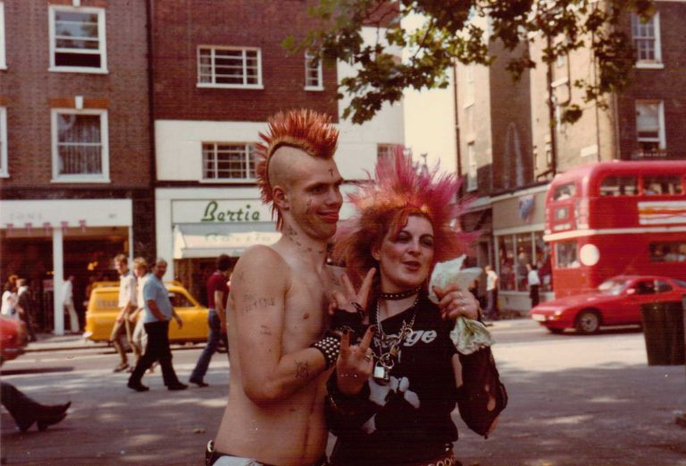

Countercultures
When a group’s beliefs conflict with mainstream culture

Slide 20

How Culture Creates Inequalities

Slide 21

Cultural Capital
Knowledge, travel, experiences, language immersion
Used in employment
In-group status
Who has it and who doesn’t?

Slide 22

Pierre Bourdieu
Cultural capital is useful in a field, employed using our habitus
Field: the contexts of social relations wherein a particular kind of cultural capital is exchanged, like a profession, a community, or a class of people.
Habitus: learned dispositions, a set tendencies organizing how we see the world and act within it.

Slide 23



Taste

Slide 24
Culture and the Individual
Do you agree that high culture drives inequality? What happens when popular and high culture collide? What about people who adopt from both?
What happens when a subculture is co-opted and commodified? For example, goth was an anti-material subculture that was turned into the mainstream store, Hot Topic. What is another example of a subcultural group and how does it illustrate the cycle of culture?

Slide 25
The Simple Joys of the Dull Men’s Club
https://www.youtube.com/watch?v=EjGKk7bee_M (3:16 minutes)
What does this tell us about material culture?
What does this tell us about social norms?
In 100 years from now, what part of our material culture might qualify for a “dull hobby”?

